Slide 1
AUDI Q5 HL OUTER LENS
Incoming Inspection Report
Incoming Inspection Performed by: José Alberto Pérez
TOOL MAKER
Juárez , México
DATE: 04-11-2015

Slide 2
Tool General Information Identification Plaques.
Injection layout – Hot Runner System ,Plaques, tests .
Layout Cavity Side (Main appearances ).
Slides , Retractors , Lifters Details.
Layout Core Side (Main appearances ) .
Ejector System & Parts .
Locating Ring.
Electrical Plugs .
Water Leaks Test.
Spare Parts , Documents ,Tool manuals etc. Received .
Observations / Summary.
Quick Check List.

Slide 3
Tool Identification plate
✓
IDENTIFICATION
Tool Source : PROSPECT MOLD
Job : 3312
Part Number: 6002TC0397/98
ALNA Number# 490
BACK TO INDEX

Slide 4
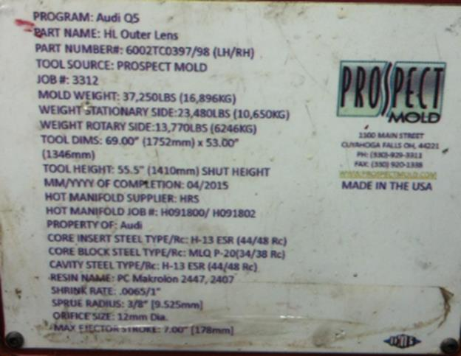
General Information
✓
Owner of Tool: AUDI AG.
MOLD WEIGHT : 16,896Kg.
TMOLD SIZE (axbxc): 69”X 53” X
55.5”
Nozzle radius: 19.05mm
Injection diameter : 12mm.
BACK TO INDEX

Slide 5
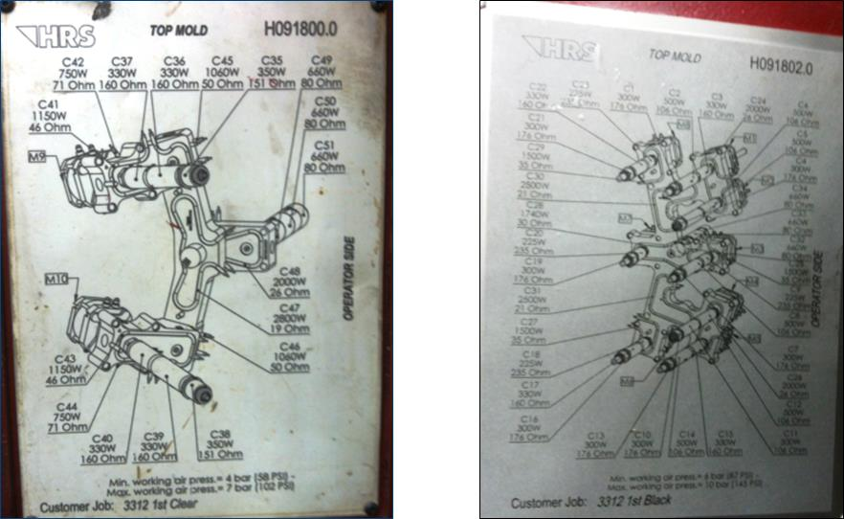
Hot Runner System
Hot Runner System #
H091800.0 H091802.0
Zone Hot Nozzle system:
1° Clear 17 Zones
1° Black 34 Zones
✓
BACK TO INDEX

Slide 6
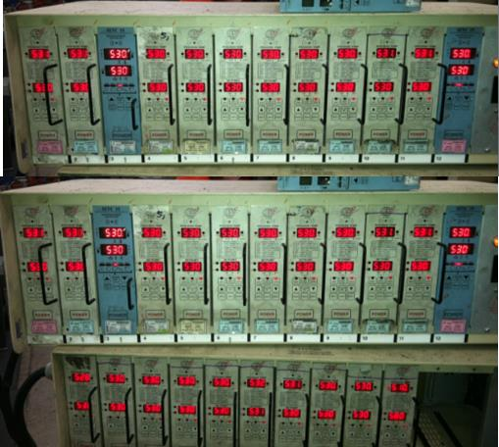
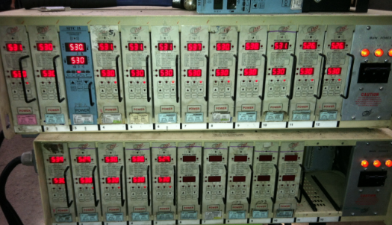
Hot Runner System Testing
✓
2ND SHOT CLEAR
All zones of the mold is heated to 530° F.
1st. Shot Black
Testing the hot runner system comments:
All Zones Reached Its Proper Temperature And Testing The Hot Runner System Everything Is Ok!
BACK TO INDEX

Slide 7
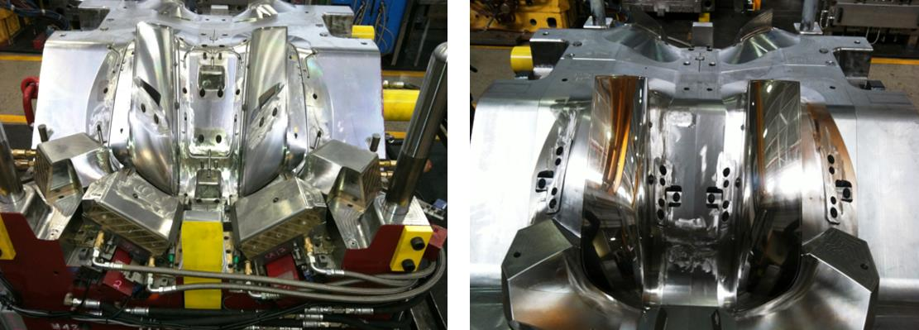
Lay outs – Cavity Side
Mold Cavity – How many Cavity ?
✓
No visible Damage founded
BACK TO INDEX

Slide 8
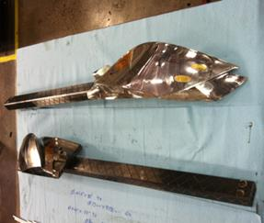
Slides, Retractors , Lifters etc.
✓
MOLD DO NOT HAVE THE FOLLOWING SYSTEMS: SLIDES AND RETRACTORS.
 |  |  | COMMENTS
NO. OF LIFTERS |  |  | 10
NO. OF SLIDES |  |  | 4
DAMAGES |  |  | NO VISIVLE DAMAGRES
WATER LEAKS |  |  | NO WATER LEAKS
PLUGS - PRESS FIT OR THREADED |  |  | THREADED
STOPPER
WATER CONNECTOR SIZE |  |  | ¼” NPT
MOVEMENTS |  |  | N/A
CAM PIN POSITION |  |  | N/A
SLIDE RETAINER |  |  | N/A
BACK TO INDEX

Slide 9
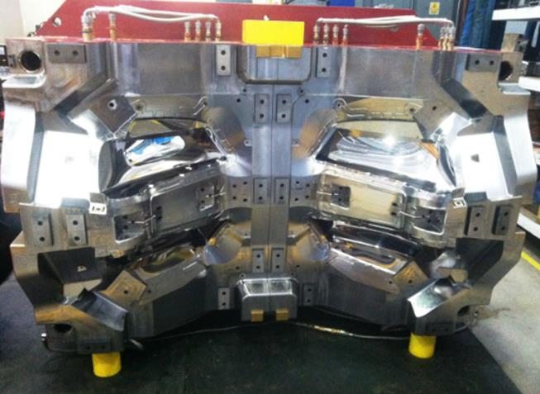
Core Layout
✓
Station 1
Station 2
Frontal View cores LH& RH, comments:
No visible Damage founded
BACK TO INDEX

Slide 10
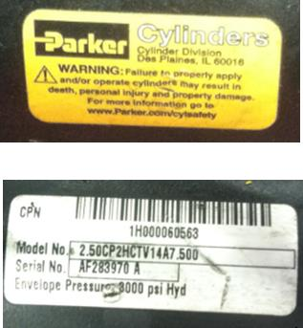
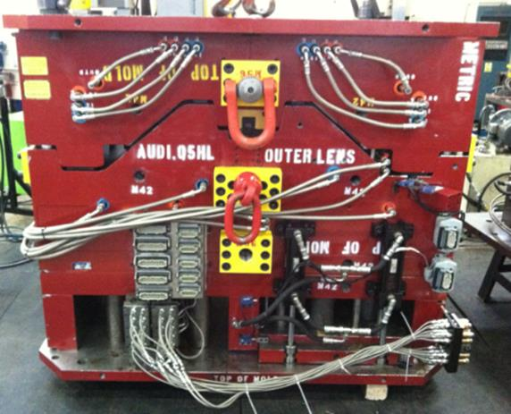
Ejector System
✓
Ejection System Has The Following Configuration:
EXPULSION SYSTEM WORKS WITH HYDRAULIC PISTONS
Model No. 2.50CP2HCTV14A7.500
Serial No. AF283970 A
Envelope Pressuer: 3000 psi Hyd.
BACK TO INDEX

Slide 11
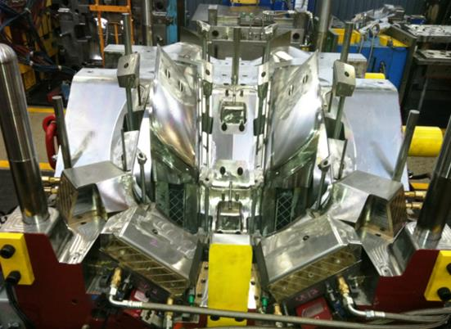
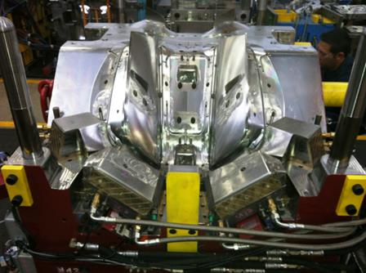
Ejector System
✓
Ejector system backward position picture
Ejector system forward position pictures
Ejector System Tested ? , Back and Forward Position ?
The Ejector System Is Ok!
BACK TO INDEX

Slide 12
Ejector system parts
✓
BACK TO INDEX

Slide 13
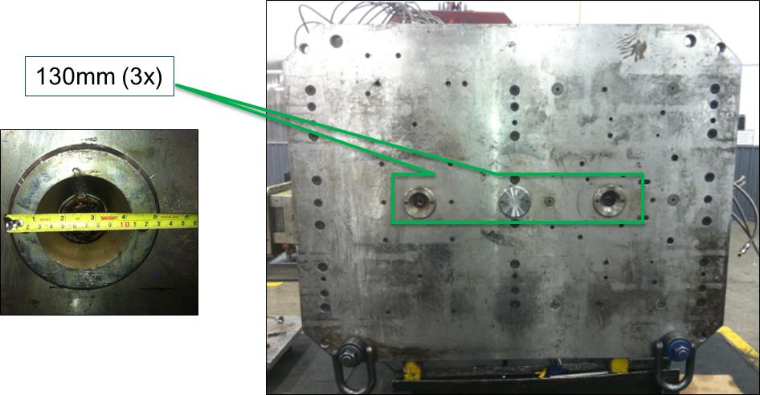
Locator Ring
✓
How many Locating rings ?
TREE
Sizes?
130mm
BACK TO INDEX

Slide 14
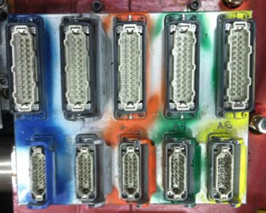
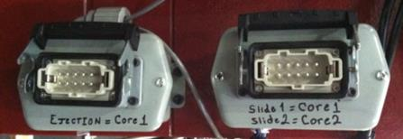
Electrical Parts
✓
Conector Plug for Hot Runner System.
Conector standard D-M-E per Heater and Thermocouples ?
10 for 1° Clear 17 Zones & 1° Black 34 Zones
Conector standard For Limit Switch D-M-E?
1 For The Ejector Plate & 1 For The Slides
heaters and thermocouple.
Limit Switch Connector
BACK TO INDEX

Slide 15
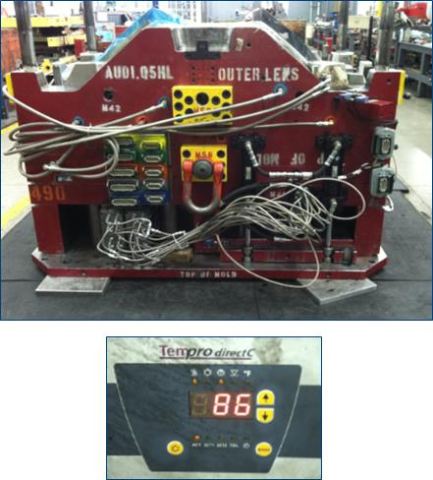
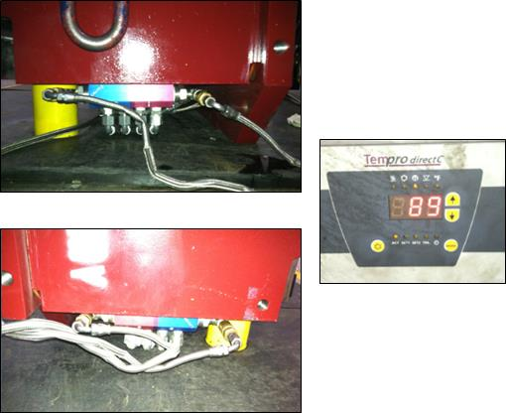
Water leak Testing
✓
CAVITY SIDE
CORE SIDE
Test Both sides of the tool with water at desired temperature ? comments:
THE CAVITY AND CORE SIDE ARE TESTED AT 90°C , NO WATER LEAKS
BACK TO INDEX

Slide 16
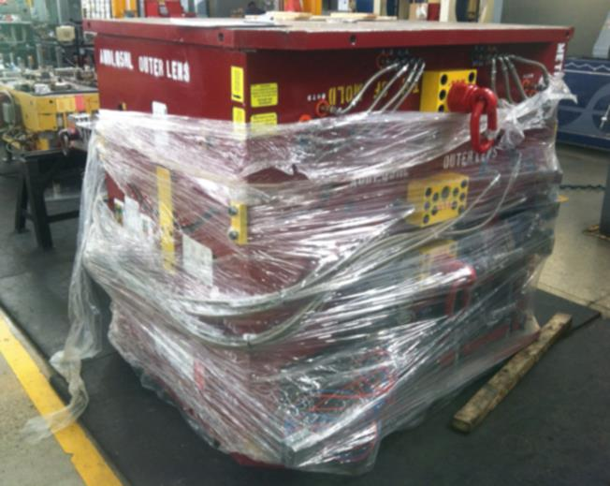
Spare parts ,Documents , Tool Manual etc. Received
✓
the mold arrived with documents & Cd.
BACK TO INDEX

Slide 17
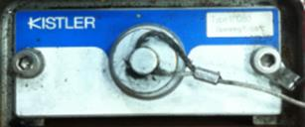
Observations
✓
In The Incoming Inspection Not Detected Failures
The Ejector System Is Working Ok
The Hrs Is Ok.
No Visible Damage Founded
Cooling System Ok
The Mold Has Pressure Sensors.
Type 1710B0
Operating T. 125° C
BACK TO INDEX

Slide 18
Quick Checklist
L# | DESCRIPTION | YES | NO | N/A | COMMENTS / OBSERVATIONS
1 | LOCATING RINGS | ✓ |  |  | How many numbers? 2
2 | AIR VENTS & ITS DEPTH | ✓ |  |  | Availability of sufficient number of air vents? YES
3 | INTERLOCKS ( PARTING LINE LOCKS ) |  |  |  | How many? FOR
4 | DATE INSERTS OR ENGRAVING |  | ✓ |  | Specify how many years? 6 (2015-2020)
5 | HOT RUNNER SYSTEMS NUMBER | ✓ |  |  | H091800.0 H091802.0
6 | THERMOCOUPLE & RESISTANCE SPARES | ✓
7 | EJECTOR BLADES |  |  | ✓
8 | VALVE GATES AVAILABILITY |  |  | ✓
9 | ANGLE PINS FOR SLIDES |  |  | ✓
10 | LOCKING CYLINDERS AVAILABILITY |  |  | ✓
11 | SPRINGS ON EJECTION SYSTEM |  |  | ✓ | Color ?
12 | TEXTURES IN CAVITY |  | ✓
13 | IDENTIFICATION ON ALL PARTS | ✓
14 | HYDRAULIC PISTON FOR CORES |  |  | ✓
15 | LIMIT SWITCHES (MICRO SWITCH) | ✓
16 | RJG OR SPECIAL SENSORS |  | ✓ |  | Specify ?
17 | SAFETY LOCK
18 | INSERT CHANGES SPARES | ✓ |  |  | ONLY FOR CLOSE DOWN CAVITIES
19 | MOLD DRAWINGS & CD |  |  | ✓
BACK TO INDEX

Slide 19
Quick Checklist
MOLD NUMBER | 3312
PART NUMBER | 6002TC0397/98
PART NAME | AUDI Q5 HL OUTER LENS
NO. OF CAVITIES | 4
CAVITIES MARKED NO.'S | LH-RH
TOOLING ENGINEER NAME | FRANCISCO MELENDEZ
MOLD ARRIVAL DATE | 29/09/16
MOLD INCOMING INSP. DATE | 01/10/16
FREQUENCY FOR PM | 20,000 SHOTS
PRESS ASSIGNED | N/A
BACK TO INDEX

